Slide 1


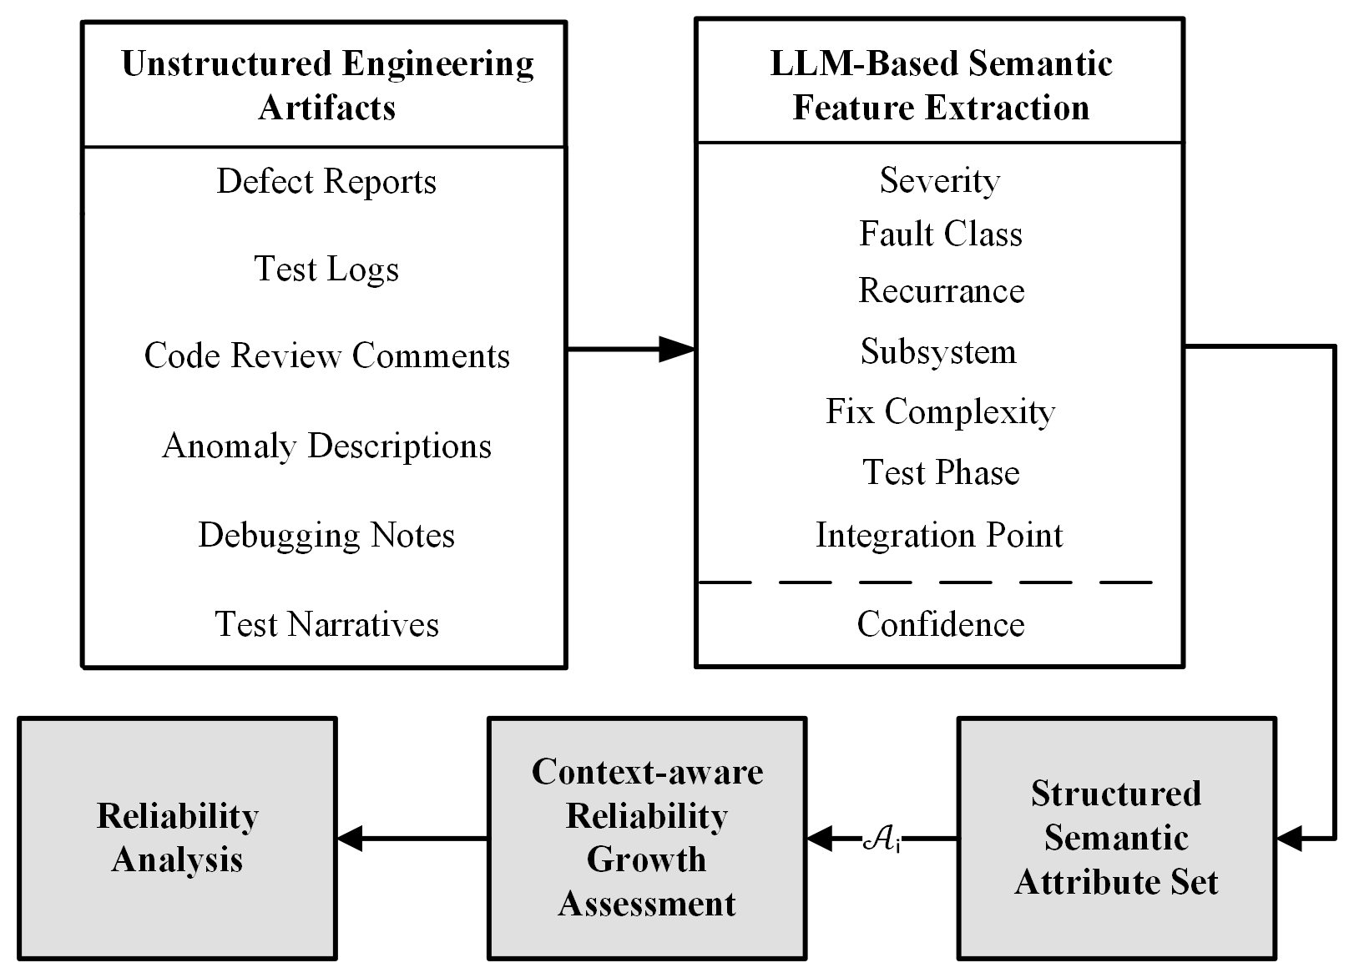
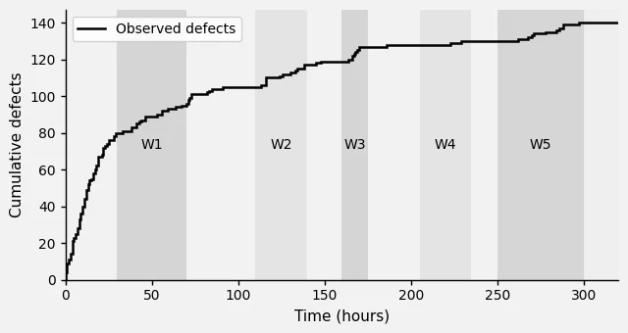
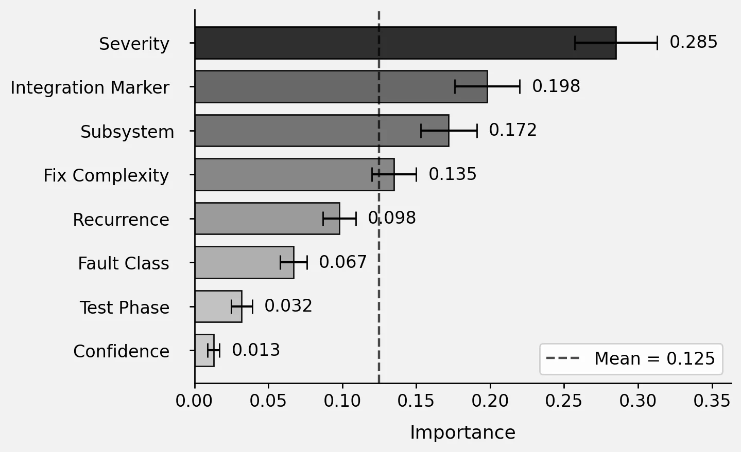
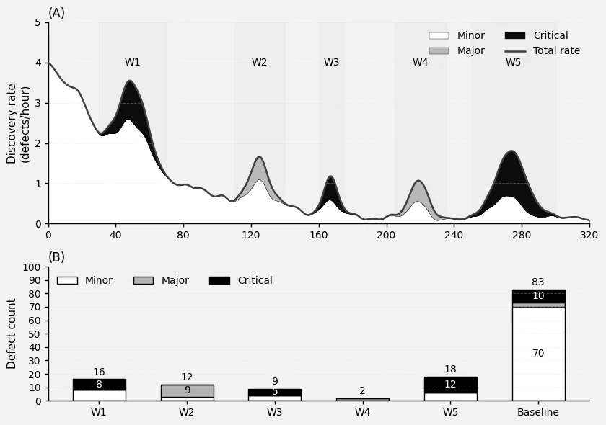
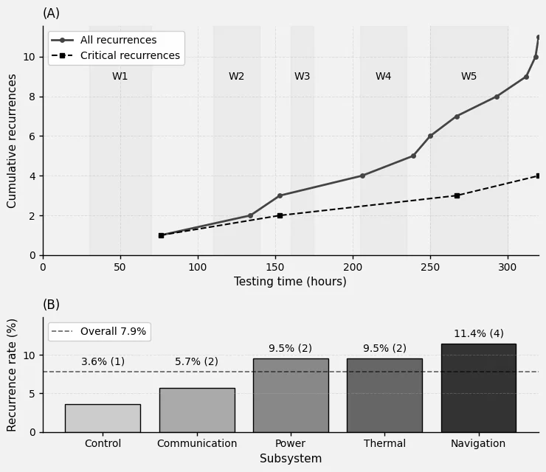
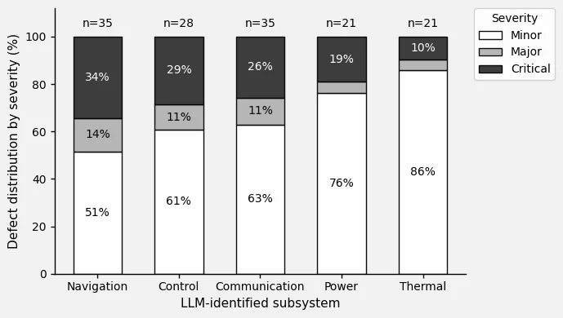
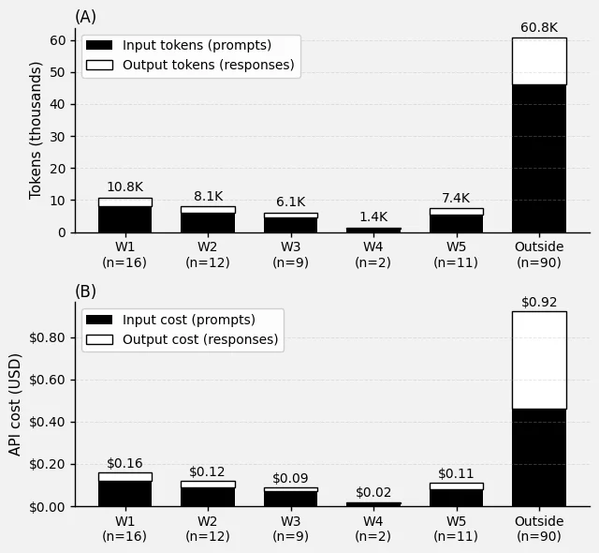
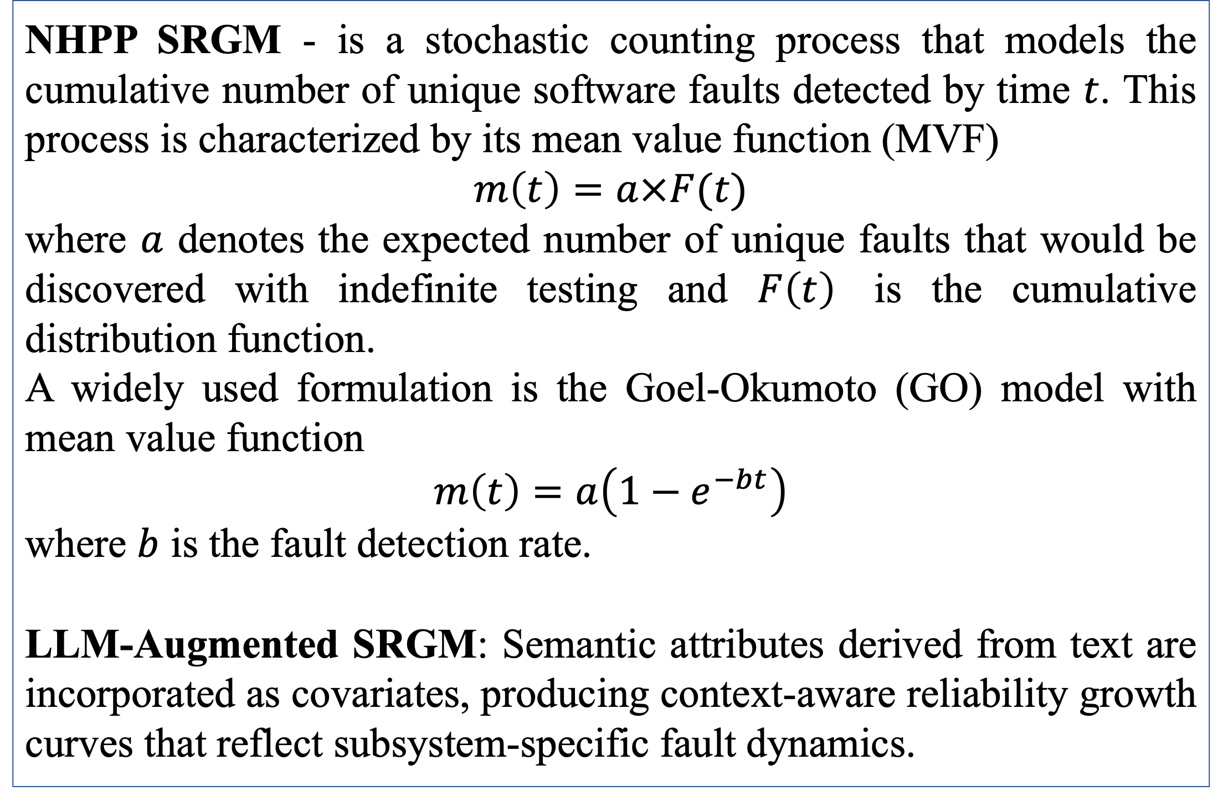
A Hybrid LLM-SRGM Framework for AI-Enabled Reliability Assessment in Safety-Critical Software Systems
Vidhyashree Nagaraju, Shrenik Jadhav, Caleb Stone
Department of Electrical Engineering and Computer Science
Embry Riddle Aeronautical University, Daytona Beach, FL USA
Introduction
Methodology
Illustrative Results (Synthetic Data Demonstration)
Detecting and predicting software faults remain critical challenges in aerospace systems, where even small defects can lead to mission-critical failures.
Traditional Software Reliability Growth Models (SRGMs) such as Non-Homogeneous Poisson Process (NHPP) models estimate fault detection trends using only numerical counts, overlooking contextual information in test logs and anomaly reports.
Regulatory Gaps exist in DO-178C, MIL-STD-882E, and NASA-STD-8739.8 which require rigorous verification and validation of software defect monitoring, yet they do not have any methods for quantifying software reliability.
Large Language Models (LLMs) can extract insight from these unstructured sources identifying severity, subsystem, and fix complexity to reveal fault patterns invisible to classical SRGMs.
Framework: A hybrid framework that integrates LLM-based fault analysis with SRGM-based failure prediction to enhance reliability assessment in aerospace software. This framework allows models to become “context-aware” rather than purely count driven.
The Conceptual Pipeline:
Unstructured Engineering Artifacts: The framework begins by ingesting large amounts of raw engineering data which is often excluded from traditional modeling.
LLM-Based Semantic Feature Extraction: We utilized GPT-4 Turbo to analyze and process the artifacts and extract eight different semantic attributes.
Structured Semantic Attribute Set: The extracted semantic attributes are combined into a singular vector that is ready for mathematical modeling.
Context-aware Reliability Growth Assessment: Application of the semantic feature vector into a standard Non-Homogeneous Poisson Process (NHPP) model.
Reliability Analysis: The output of the model is shown as a reliability analysis for the given software.
.
Figure 2: Software defect discovery over a 320 hour testing period with W1-W5 representing different software phase transitions.
Figure 3: Importance of each semantic feature in relation to overall software reliability.
Figure 1: A hybrid SRGM-LLM multistage framework transforming qualitative engineering artifacts into quantitative reliability predictions.
Figure 4: Defect discovery is shown to be greatest during phase transitions
Figure 5: Extracted defect recurrence indicators demonstrate software debugging effectiveness.
Background
NHPP SRGM - is a stochastic counting process that models the cumulative number of unique software faults detected by time $t$. This process is characterized by its mean value function (MVF)
$$m\left(t\right)=a×F(t)$$
where $a$ denotes the expected number of unique faults that would be discovered with indefinite testing and $F\left(t\right)$ is the cumulative distribution function.
A widely used formulation is the Goel-Okumoto (GO) model with mean value function
$$m\left(t\right)=a\left(1−e^{−bt}\right)$$
where $b$ is the fault detection rate.
LLM-Augmented SRGM: Semantic attributes derived from text are incorporated as covariates, producing context-aware reliability growth curves that reflect subsystem-specific fault dynamics.
Outcomes
Figure 6: Our model demonstrates effectiveness in its ability to identify the reliability of specific subsystems within a software.
Figure 7: Use of GPT-4 Turbo for our hybrid model cost ~$1 per 100 defects and process these defects in less than .5 hours.
Validated LLM + SRGM Proof-of-Concept
Quantitative Performance Results
Empirical Insights on Fault Patterns
Contact
Acknowledgment
Vidhyashree Nagaraju
Vidhyashree.Nagaraju@erau.edu
(386) 226-6455
Shrenik Jadhav
jadhavs2@my.erau.edu
(734)773-5757
Caleb Stone
stonec16@my.erau.edu
(502)777-9035
This work is based on a proposal prepared for the Center for Aerospace Resilience (CARS) Seed Grant at Embry-Riddle Aeronautical University.

